Slide 1
TRK energy regression: CrossAttention vs range-based baselines
TRK energy regression: CrossAttention vs range-based baselines
Same MATE simulated events; direct CNN energy regression compared with range-to-energy reconstruction.
0.0188
18%
5
CrossAttention RMSE (MeV)
lower RMSE than ResNet
methods compared
TRK energy regression
1 / 17
Notes:
This is the compact claim for the advisor: on the current common test split, CrossAttention has the lowest RMSE among the five compared methods. Frame it as physics-motivated energy regression, not as a generic ML victory. The caveat is that this is still the current single-seed/common-split comparison, so the result is strong evidence for this deck, not yet the final multi-seed paper claim.

Slide 2
Experiment setup: common image input, two regression routes
Five methods compared on the same image:
Cross-Attention and ResNet predict E directly (without reconstructing tracks at all)
RANSAC, Hough, and Hierarchical Clustering reconstruct the track first, then convert range to energy via SRIM.
Objective: To compare the performance of CNNs with that of traditional algorithms(RANSAC, Hough, and Hierarchical Clustering)
180,000 test events
1-4 alpha tracks per event
truth E ~ U[0.3, 4.0] MeV
E1 = ? MeV
GAP + flatten (B, 512)
Mod. ResNet-18: conv1=3x3 s1, no maxpool; layer4 -> (B,512,10,6)
Linear (512 -> 128)
classifier_hidden_dim from config
E2 = ? MeV
ReLU
alpha source
Dropout (p = 0.05)
training mode only
E3 = ? MeV
Linear (128 -> 4)
num_classes = 4 per-track energy slots
out_0
0.23 MeV
out_1
0.25 MeV
out_2
-1.39 MeV
out_3
1.38 MeV
TRK energy regression
2 / 17
Notes:
I will briefly introduce the context and the configuration of the new experiment, Previously, we conducted classification and regression studies using an isotropic alpha source, in which the number of tracks ranges from 1 to 4. After successfully determine the track multiplicity and angles for each event, the next step is to perform energy regression to figure out the ability boundary of each approach further. To this end, we will compare 5 approaches: three traditional algorithms, namely Hough, RANSAC, and Hierarchical Cluster, and two ML approaches, namely Standard ResNet and Cross-Attention ResNet.

Slide 3
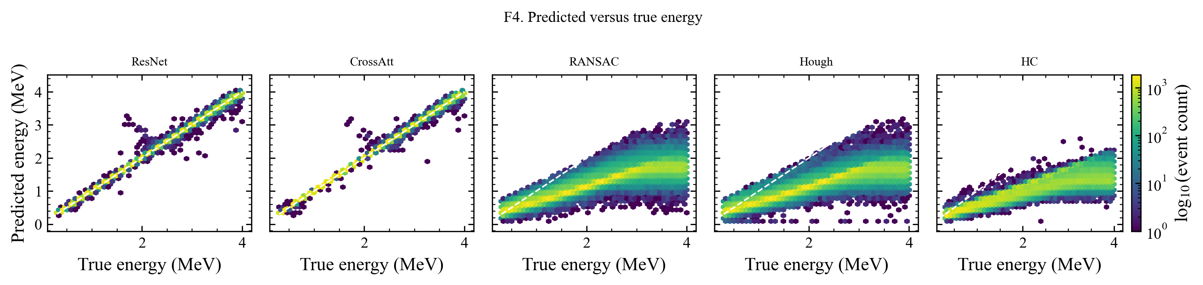
Predicted energy vs truth: visual preview across methods
Total Energy
Inspect the events near 2MeV
Separate the track multiplicity
TRK energy regression
3 / 17
Notes:
Use this as the visual preview before the metric table: the CNN panels stay close to the diagonal, while the range-based baselines show broader scatter and saturation-like structure. Then move to the next slide for the quantitative RMSE, MAE, and missing-track summary.

Slide 4
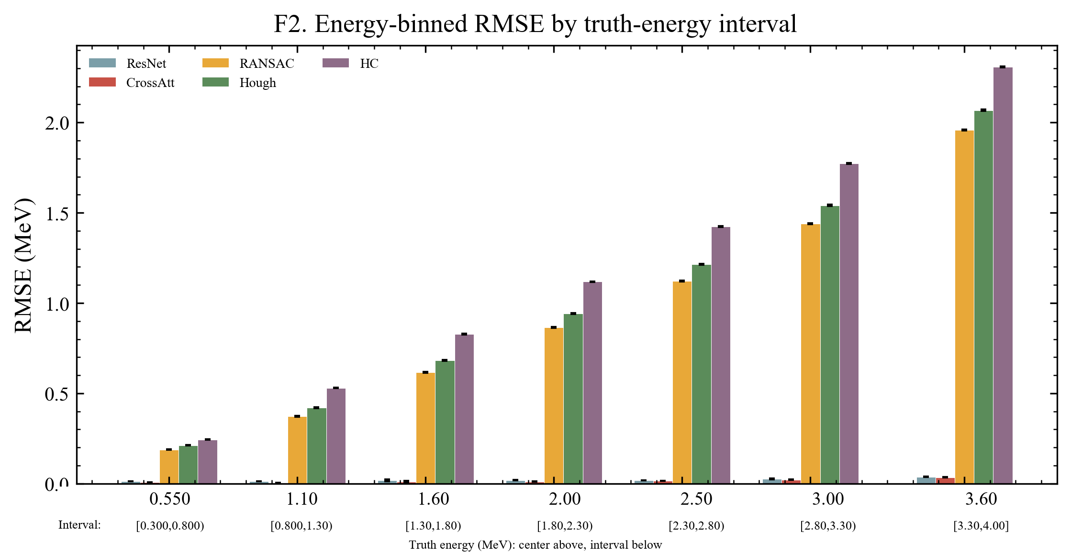
Energy bins: CrossAttention leads, especially below 2 MeV
Per-bin RMSE confirms the main effect; high-energy bins remain harder because tracks are more often clipped.
Low-energy advantage
CrossAttention is especially strong below about 2 MeV.
High-energy regime
Clipping and partial tracks make this the harder region.
TRK energy regression
4 / 17
Notes:
This checks whether the gain is only an average effect. The energy-binned plot shows CrossAttention remaining competitive across bins, with the advantage most visible in the low-energy region. The physics caveat is that high-energy tracks are harder because clipping becomes more frequent.

Slide 5
Main result: CrossAttention has the lowest RMSE and MAE
On 180k common test events, both CNNs outperform range-based baselines; CrossAttention improves over ResNet by 0.00433 MeV.
Method
RMSE
MAE
Missing tracks/ratio
+0.00433
CrossAttention
0.0188
0.0093
0 / 0.00%
ResNet - CrossAttention paired event-RMSE diff (MeV)
ResNet
0.0229
0.0137
0 / 0.00%
RANSAC
1.1734
0.9663
11,513 / 2.56%
[0.00426, 0.00440]
Hough
1.2691
1.0495
37,780 / 8.40%
bootstrap interval
HC
1.4190
1.1970
126 / 0.03%
180k
Total events: 1,200,000
Train: 840,000 events = 70%
Validation: 180,000 events = 15%
Test: 180,000 events = 15%
common events
Interpretation: CrossAttention leads all 5 methods. Both CNNs strongly outperform RANSAC, Hough, and HC after validation-only baseline tuning.
TRK energy regression
5 / 17
Notes:
This is the primary quantitative result. CrossAttention is lower than ResNet by 0.00433 MeV in paired event-RMSE, and both CNNs are far below the range-based baselines on the same 180k test events. Keep the claim precise: the table reports locally generated test results under the current locked protocol.

Slide 6
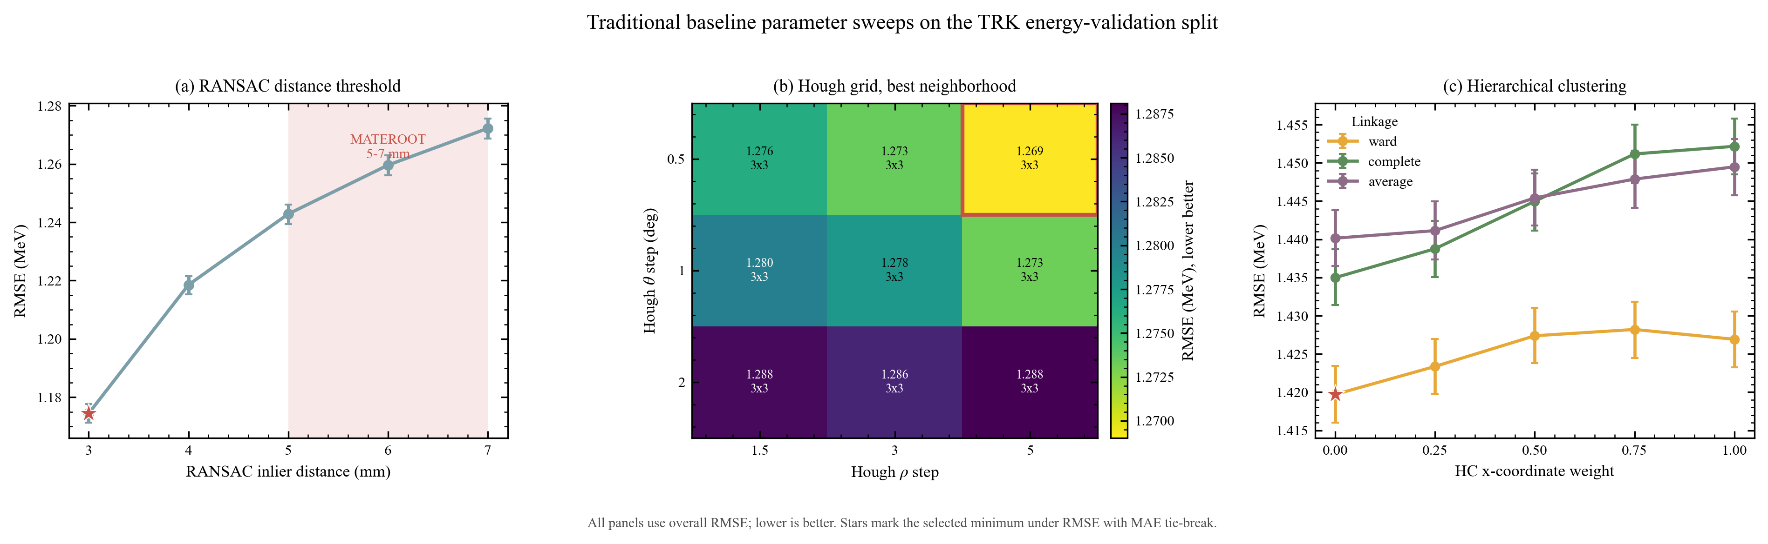
Baseline RMSE values
Citations identify method provenance only; every RMSE value below was computed in this study.
Method
Selected config
Local RMSE (this work)
Reference
RANSAC
inlier_dist_mm = 3.0
1.173 (-5.4%)
Ayyad et al., NIM A 880 (2018) 166-173.
Hough
ρ=5.0, θ=0.5 deg, NMS=3x3
1.269 (-0.7%)
Furuno et al., NIM A 908 (2018) 215-224.
HC
ward, x_weight = 0.0
1.419 (-0.6%)
Dalitz et al., CPC 235 (2019) 159-168.
Papers: cited to define/justify baseline families and parameter context; they are not where the RMSE/MAE values come from.
Their hyperparameters are selected and tuned on our validation split.
TRK energy regression
6 / 17
Notes:
This is the fairness audit for the classical baselines. RANSAC, Hough, and Hierarchy Cluster were tuned only on the validation split, then evaluated once on the untouched test split; all three improved in the same direction. The remaining gap to CrossAttention is therefore not just an under-tuned-baseline artifact.

Slide 7
Appendix: complete generated figure set
Backup evidence for review and manuscript figure selection
Appendix preserves every generated comparison and diagnostic figure.
Reference figures for review and later manuscript selection.
TRK energy regression
7 / 17
Notes:
Transition to backup material. The remaining slides are not meant to be presented one by one unless the advisor asks for a diagnostic, a baseline check, or a candidate manuscript figure.

Slide 8
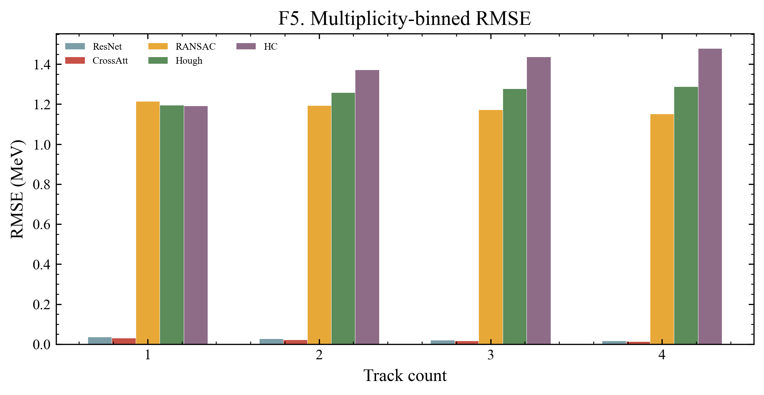
Track multiplicity: advantage survives 1-4 track events
CrossAttention remains lower-RMSE in each multiplicity bin; gains matter most when image evidence is entangled.
1-4 tracks
CrossAttention remains lower-RMSE for each multiplicity bin.
Takeaway
Attention helps when image evidence becomes more entangled.
TRK energy regression
8 / 17
Notes:
This tests whether the result disappears in multi-track events. CrossAttention stays lower-RMSE across 1-4 track multiplicities, so the advantage is not limited to the easiest single-track case. The interpretation is that attention helps when image evidence becomes spatially entangled.

Slide 9
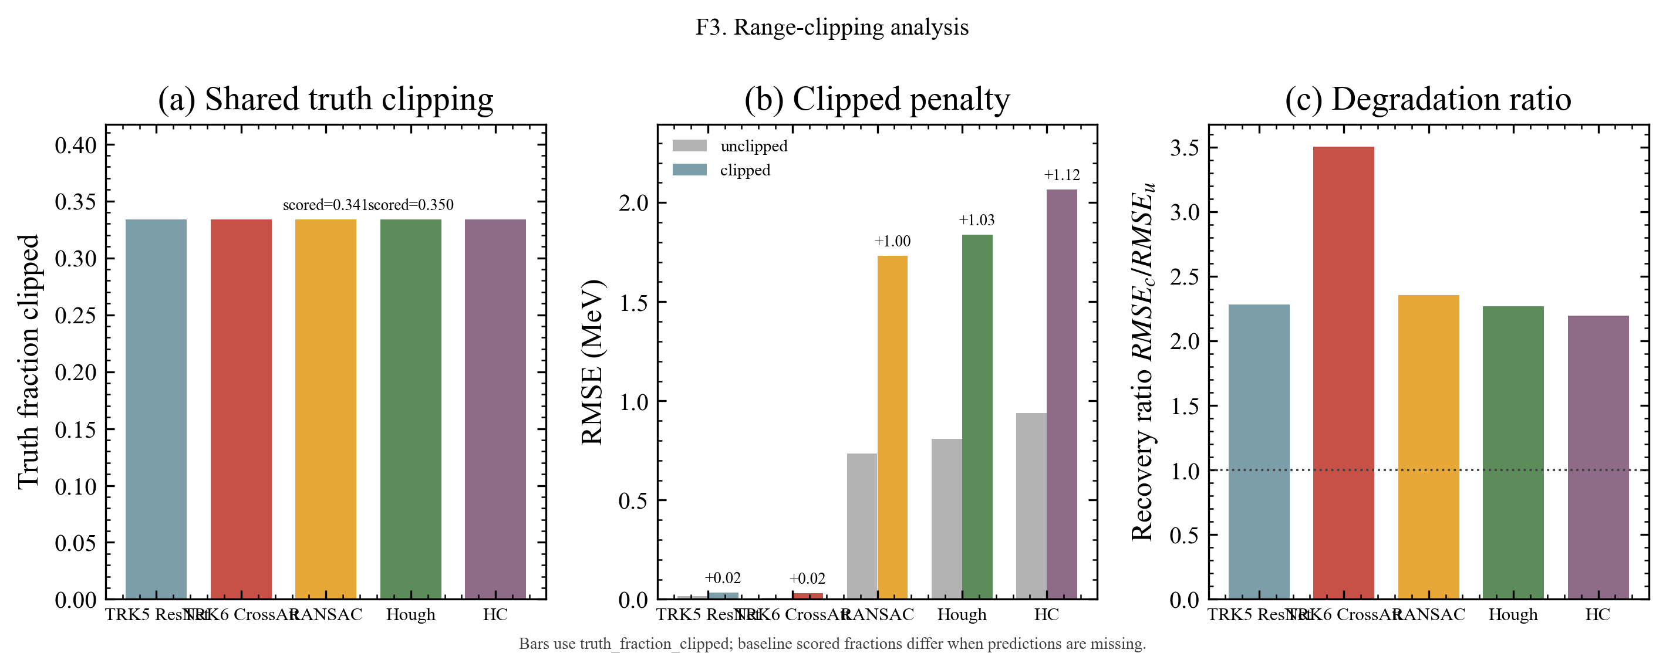
Physics: clipping makes length-only energy a lower bound
All methods share the same truth-level clipping; CNNs can use partial-track morphology beyond observed range.
Shared truth
Truth-level clipping fraction is shared across methods.
Length-only mapping
Classical baselines map observed length to energy.
Lower bounds
Clipped tracks become lower-bound estimates.
CNN advantage
CNNs can exploit charge morphology and partial-track patterns.
F3: range-clipping analysis
TRK energy regression
9 / 17
Notes:
This is the physics explanation slide. Range-based methods turn observed length into energy, so clipped tracks naturally become lower-bound estimates. The CNN does not see a clipping label; it can use partial-track morphology and charge patterns that remain visible when observed range is incomplete.

Slide 10
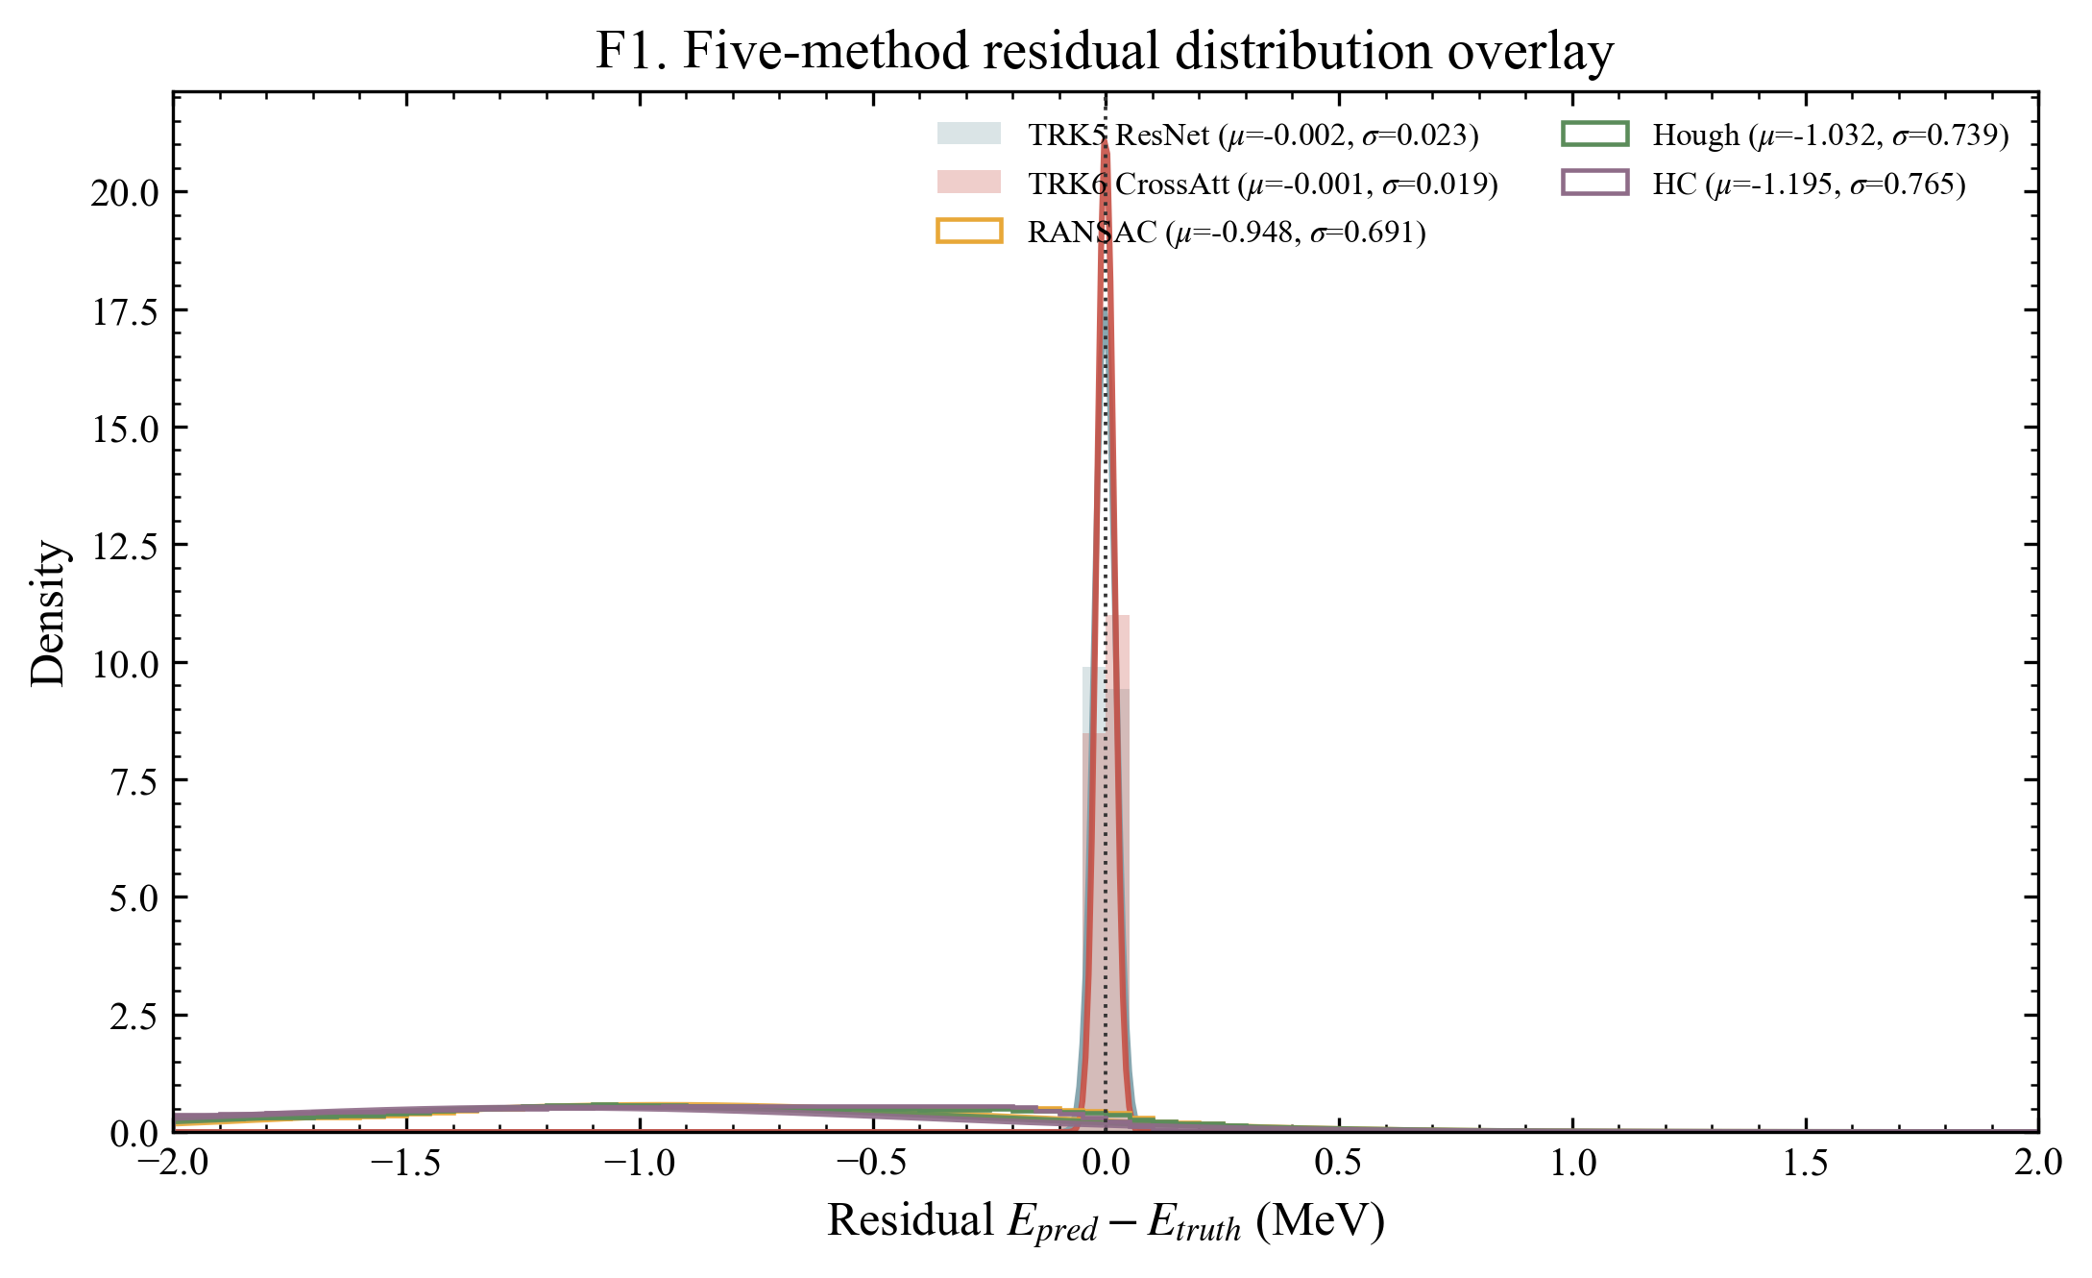
Appendix A: residual distributions across all methods
F1 residual distributions across all methods, with Gaussian-fit overlays.
TRK energy regression
10 / 17
Notes:
Backup evidence for residual shape across all methods. Use this if asked whether the headline RMSE hides asymmetric or heavy-tailed residual behavior.

Slide 11
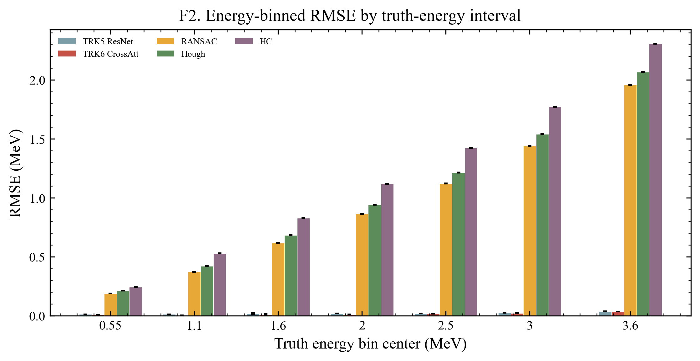
Appendix B: energy-bin RMSE
F2 energy-binned RMSE by truth-energy interval.
TRK energy regression
11 / 17
Notes:
Backup evidence for the energy-bin result, including uncertainty intervals. Use this if asked where the CrossAttention advantage is strongest or whether it survives binning.

Slide 12
Appendix C: range-clipping diagnostic
F3 range-clipping diagnostic across all methods.
TRK energy regression
12 / 17
Notes:
Backup evidence for the clipping mechanism. Use this if asked whether the range-clipping interpretation is visible across all five methods.

Slide 13
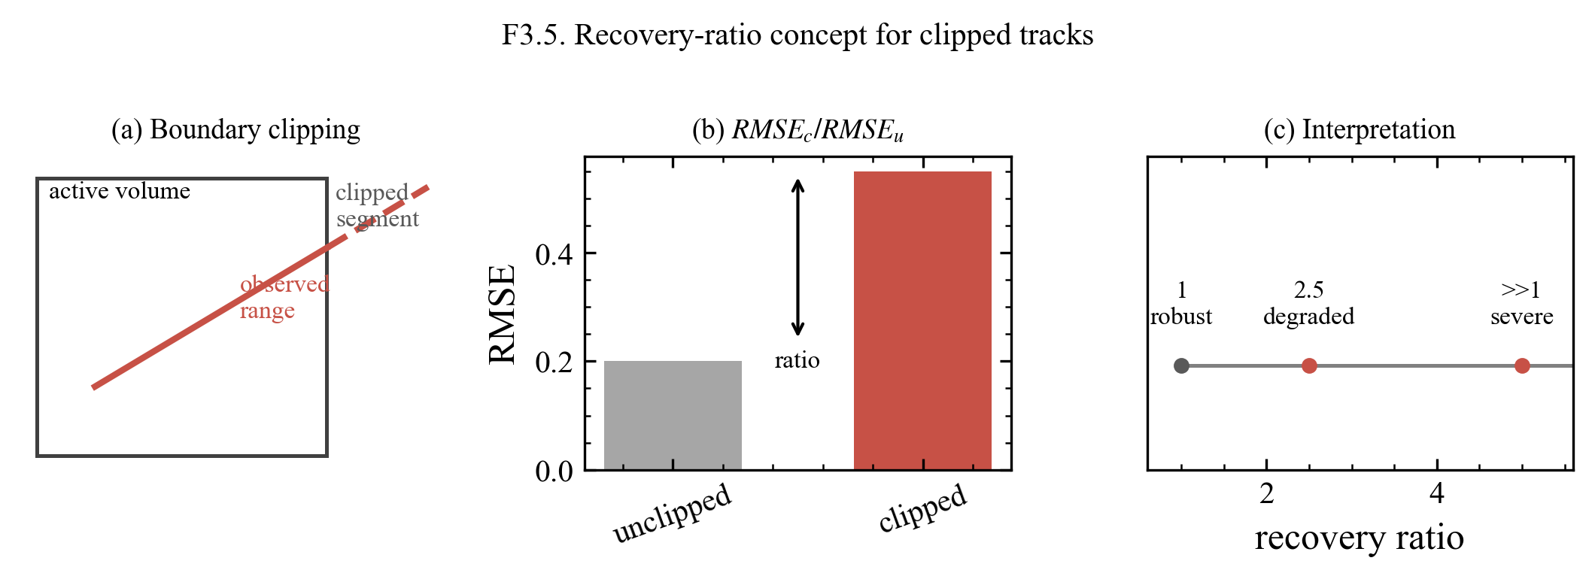
Appendix D: clipped-track recovery ratio concept
F3.5 clipped-track recovery ratio concept.
TRK energy regression
13 / 17
Notes:
Conceptual backup for the recovery-ratio metric. Use this only if the advisor asks how the clipped-track diagnostic should be interpreted geometrically.

Slide 14
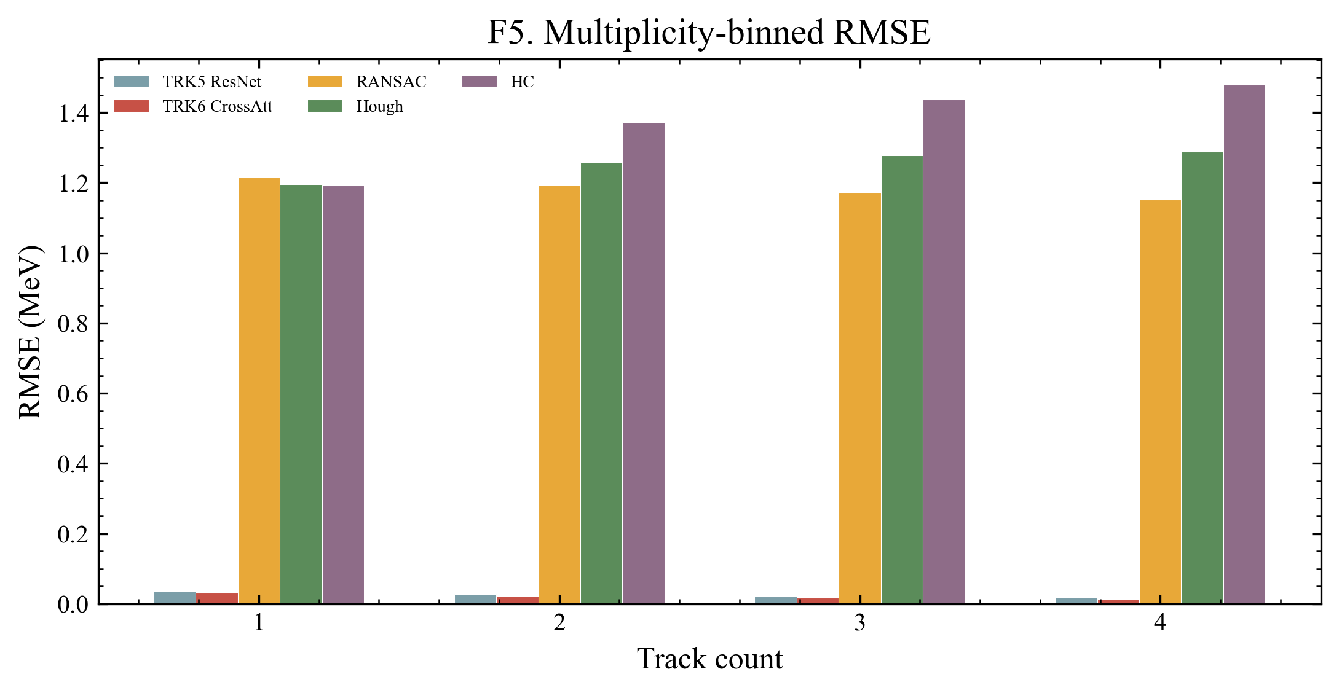
Appendix F: track-count RMSE
F5 track-count RMSE.
TRK energy regression
14 / 17
Notes:
Backup multiplicity-binned RMSE. Use this if asked whether the track-count result has uncertainty support beyond the main slide.

Slide 15
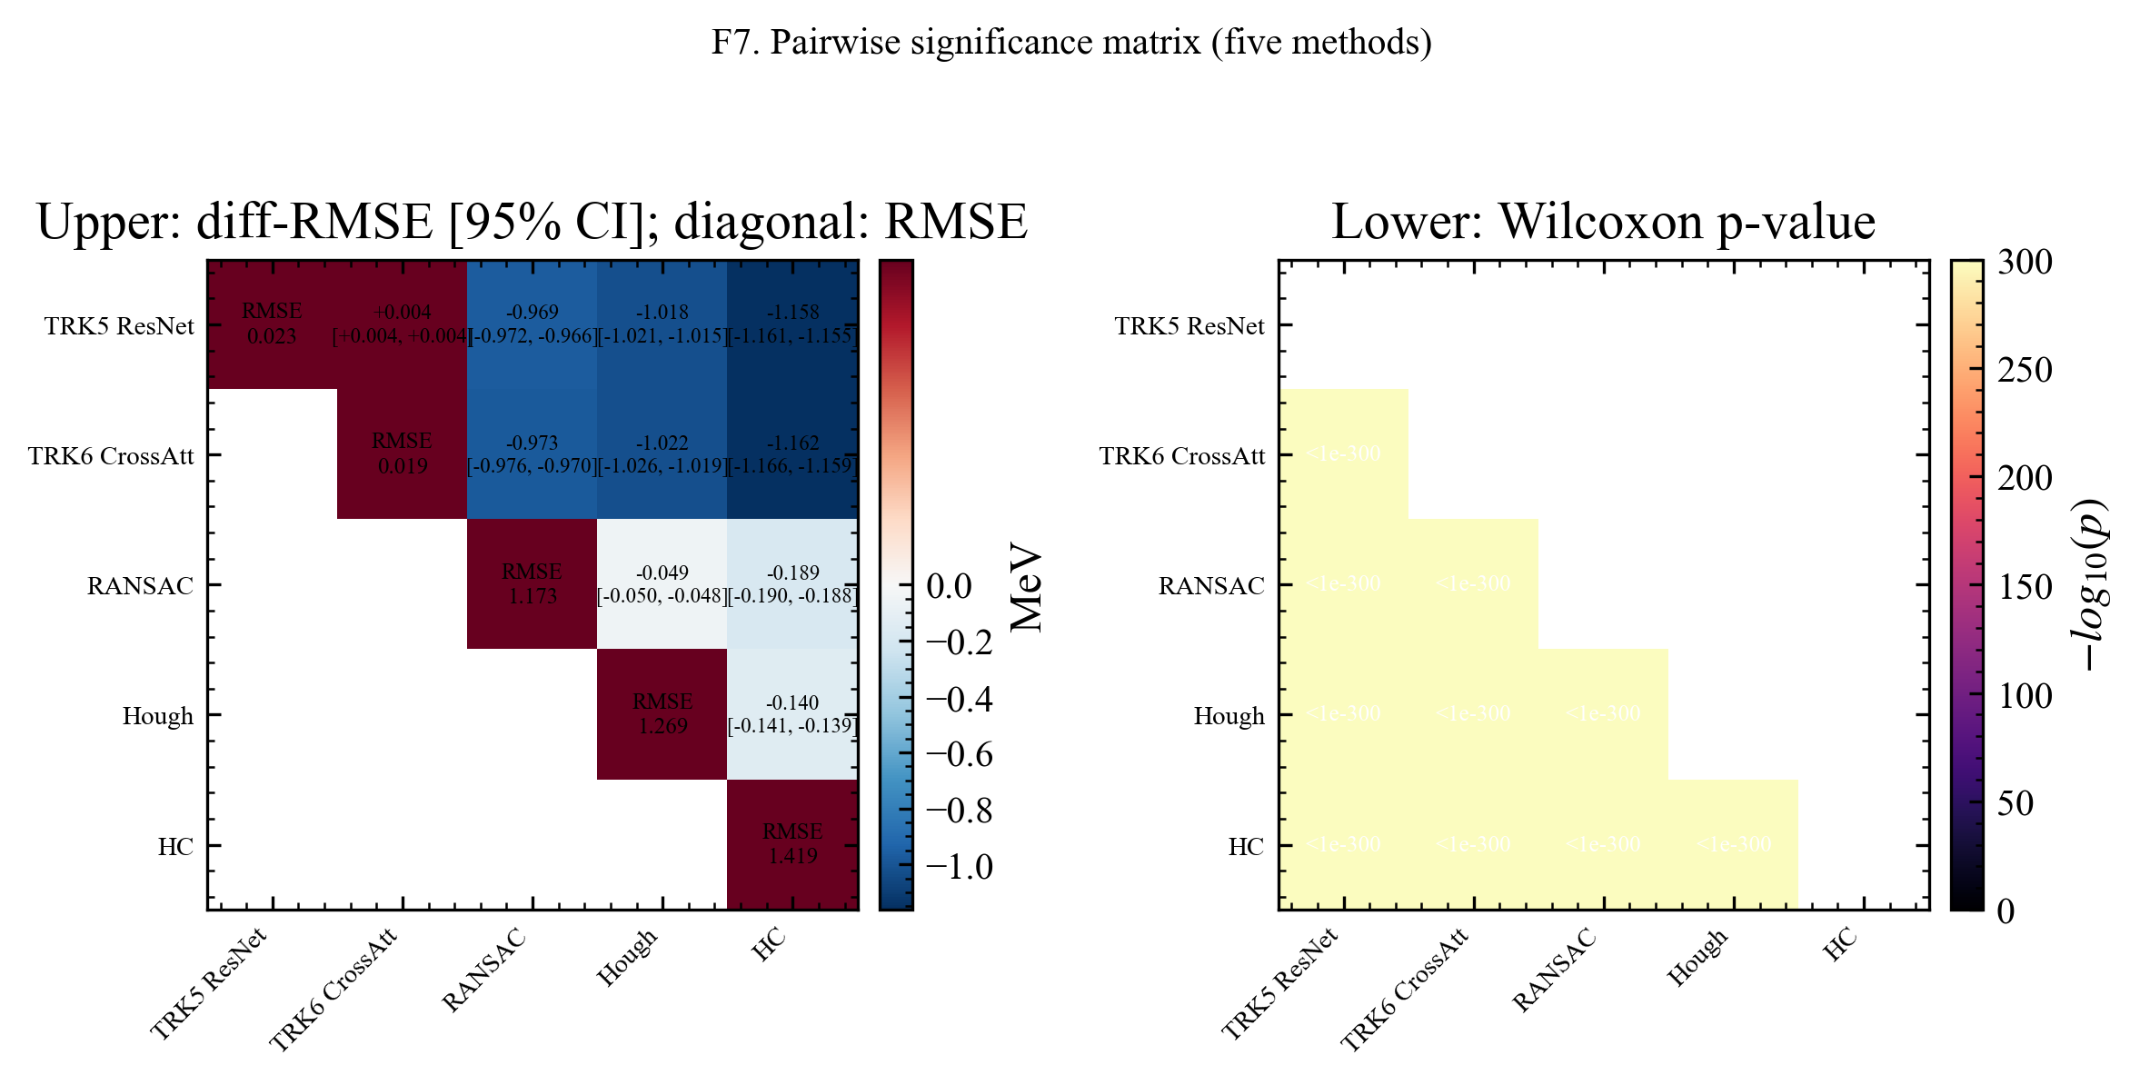
Appendix G: pairwise significance of RMSE differences
F7 RMSE-difference and Wilcoxon significance matrix.
TRK energy regression
15 / 17
Notes:
Backup pairwise significance matrix. Use this if asked whether the RMSE differences are pairwise stable, and keep the direction clear: negative differences against baselines favor CrossAttention.

Slide 16
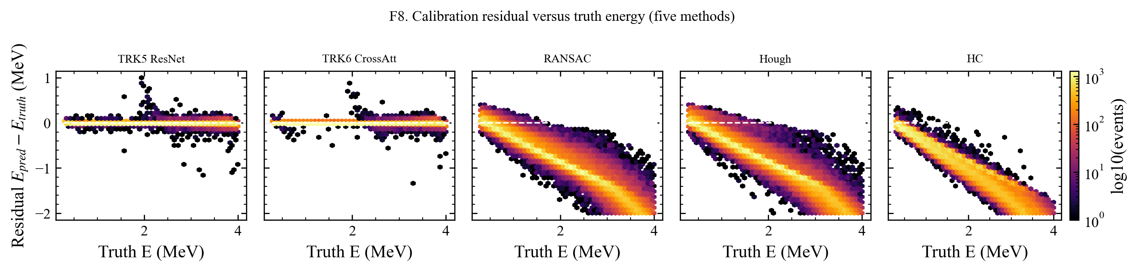
Appendix H: residual vs truth across methods
F8 residual vs truth, 1x5 method strip.
TRK energy regression
16 / 17
Notes:
Backup residual-versus-truth strip. Use this if asked whether residuals depend systematically on true energy for each method.

Slide 17
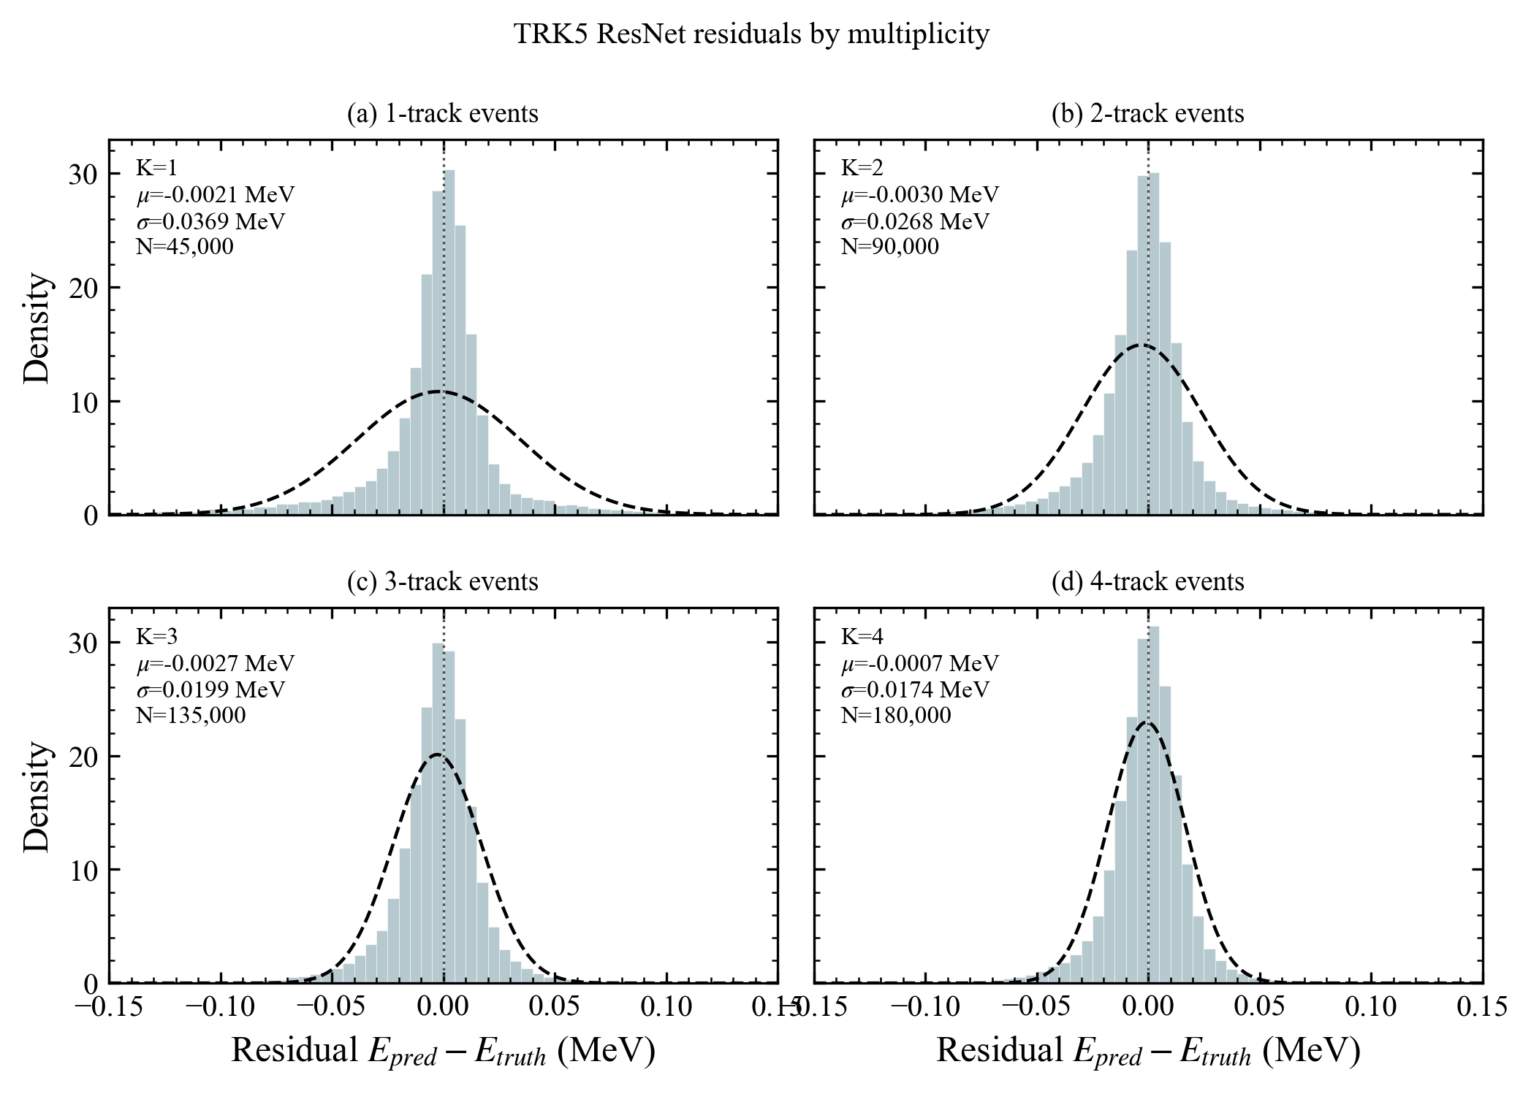
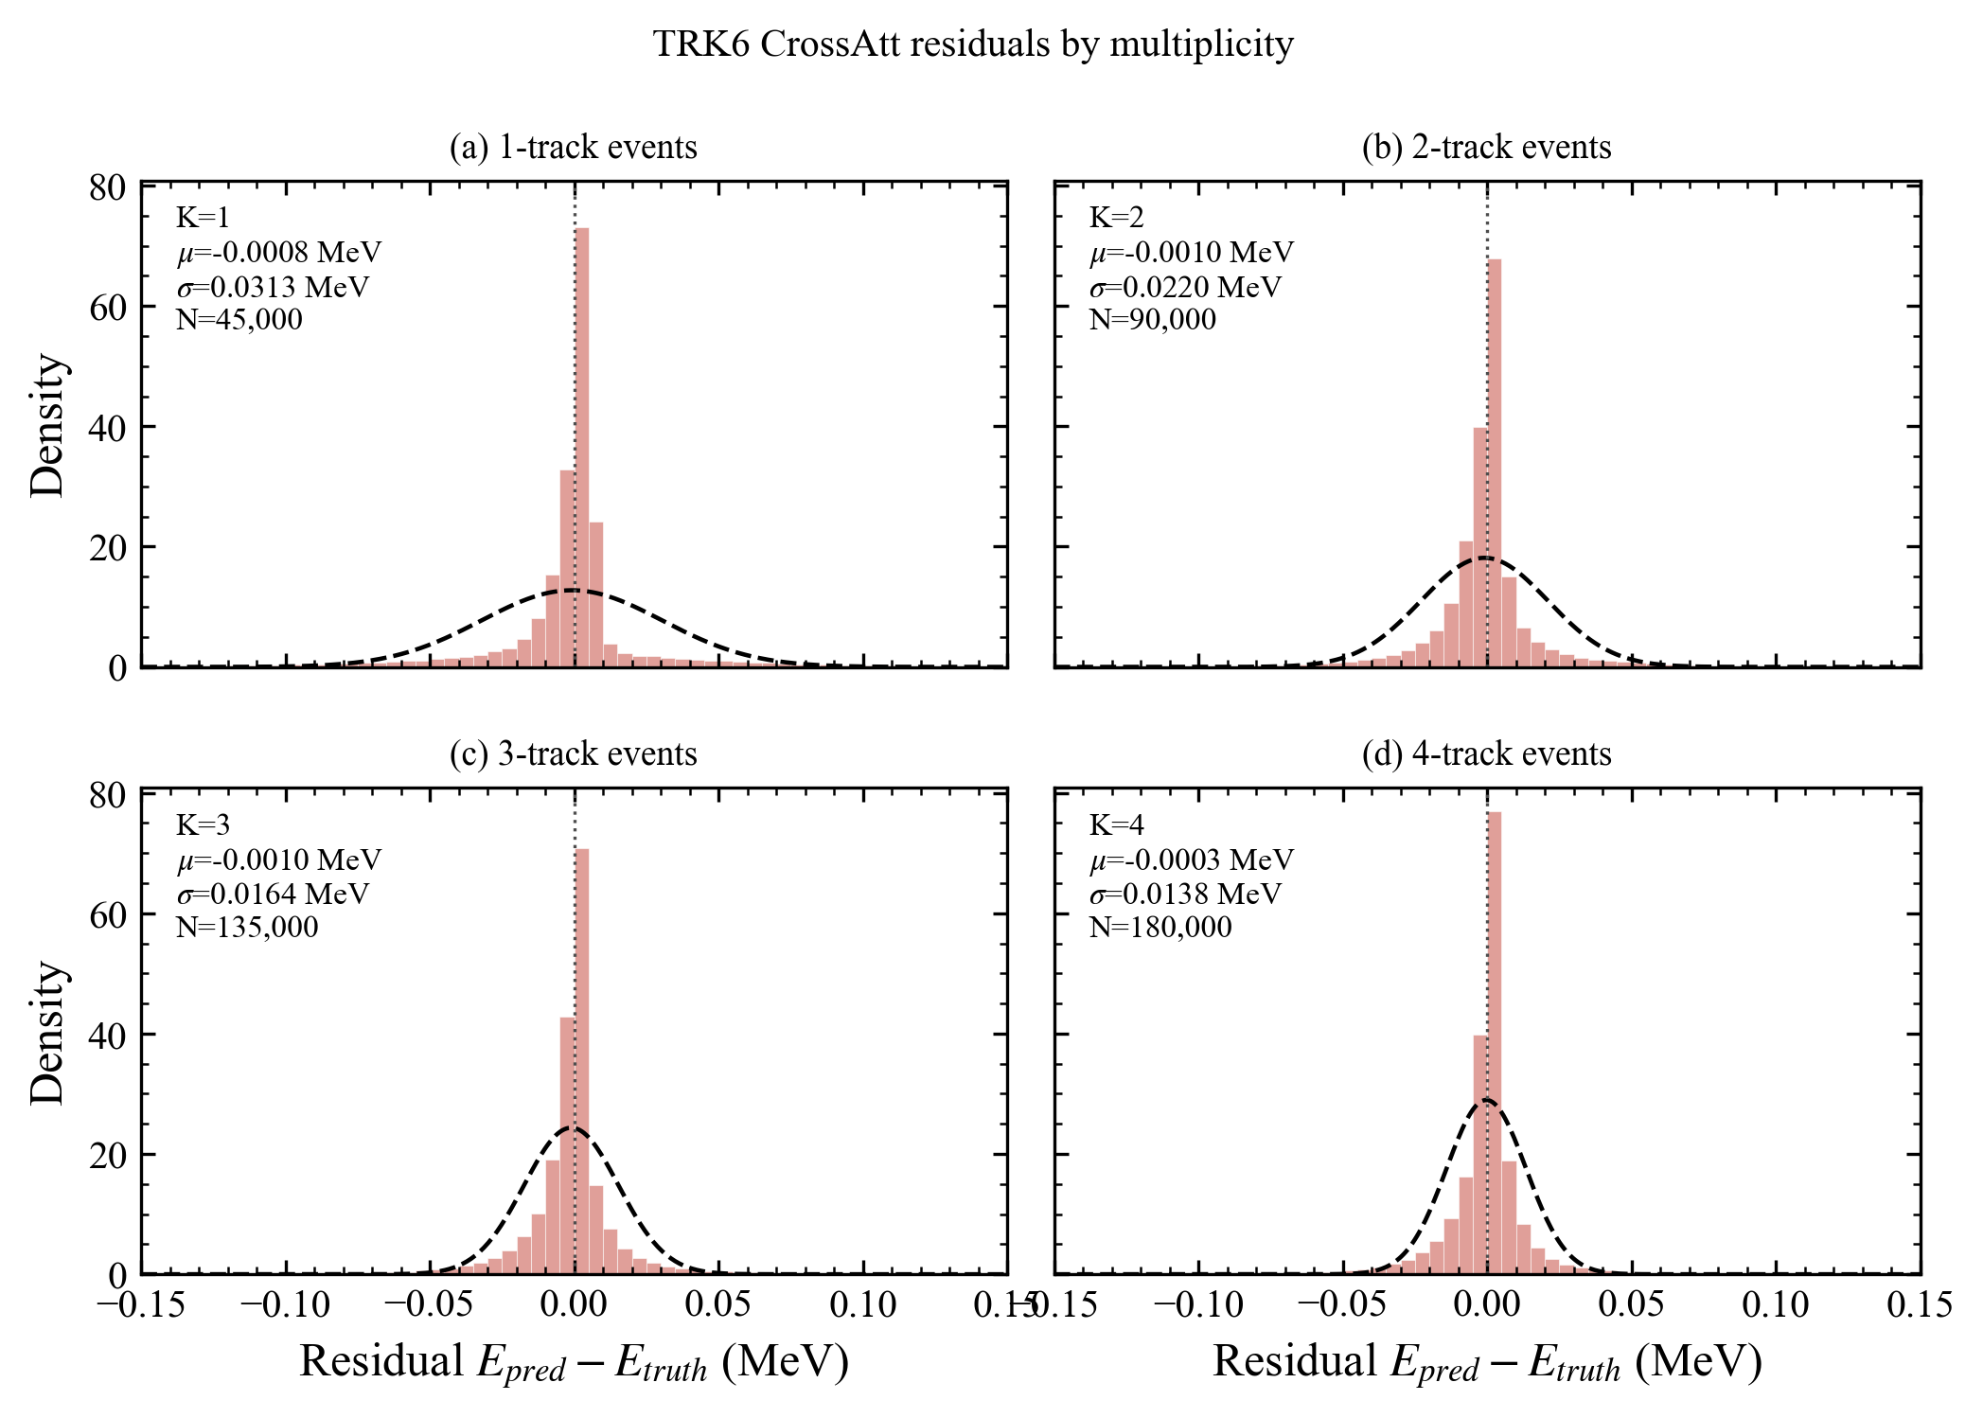
Appendix I: CNN residual histograms by track count
Per-track-count residual checks for each CNN energy regressor.
ResNet
CrossAttention
TRK energy regression
17 / 17

